Slide 1
IBM Certified WAS 8.5 Administrator
Section 5 - Security

Slide 2
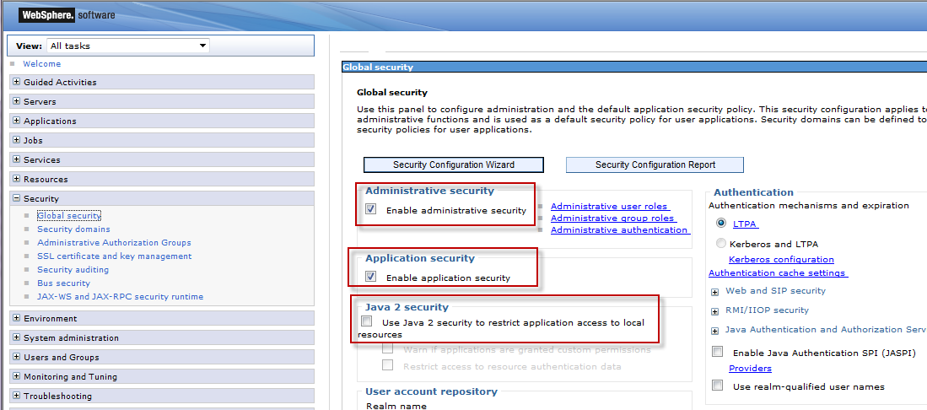
Security Overview
Three types:
Administrative Security
Application Security
Java 2 Security
Notes:
Security Service, a part of WAS runs in each WAS process (dmgr, Application Server, Node Agent etc)

Slide 3
Administrative Security
Controls access to Admin functions (such as logging on to Admin Console and wsadmin)
Administrative roles for defining access level
Fine grained access possible (you can configure to have access only to certain application servers)
Administrative security must be enabled to enable Application Security
Enabling Administrative Security enables usage of SSL
Notes:
By Default Administrative Security is enabled

Slide 4
Various Administrative roles
Monitor: View state of the environment
Configurator: Monitor + config changes
Operator: Monitor + start/stop processes
Administrator: Everything
iscadmins: Admin rights for managing users/groups in admin console ONLY
Deployer: Configure,start/stop applications
Admin Security Manager: Manage user/group/roles
Auditor: Configure Auditing subsystem

Slide 5
Application Security and Java 2 Security
Controls Application Level Security such as accessing certain parts of the application
Developer develops with ‘roles’ in mind
At deploy time, roles get mapped to groups or users by the Deployer
Security constraints in deployment descriptors control access to servlets
Method permissions in deployment descriptor control access to EJBs
Java 2 security restrict access to local resources such as files and Sockets using policy files
Notes:
Developer, at development time does not necessarily know all the users/groups that will be using the application. So, he develops with ‘roles’ in mind such as ‘operator’, ‘administrator’,’webmaster’ etc.
At deploy time, deployer (typically WAS Administrator) maps the roles to the users. This can also be done post deployment
Java comes with set of security policy files
WAS has its own policy files

Slide 6
Authentication
Authentication is the first step in the security flow (followed by authorization)
Authentication mechanism defined in the Application deployment descriptor
Basic, Form based and certificate based
Basic authentication forces the user to enter username/password. Weak encoding
Notes:
For WAS, default is ‘Basic Authentication’

Slide 7
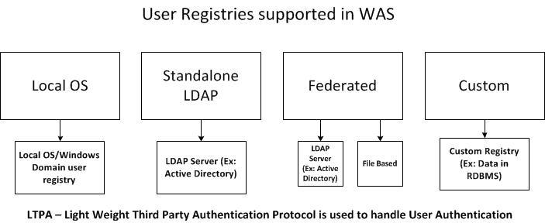
User Registries
Authentication process requires a user registry to validate username and password
Supported: Local OS (including Domain in Windows),Standalone LDAP, Custom, Federated
Notes:
Federated repositories can have more than one backed repository. Not only that, they can be of various types.
VMM (Virtual Member Manager) handles the authentication with Federated repositories.

Slide 8
Configuring Security
You can use Security Configuration Wizard from Admin console or do it manually
You will need username/password for most types of repositories (ex: Standalone LDAP bind credentials)
Custom registries required the custom classes to be available to WAS when configuring
WAS provides com.ibm.websphere.security.FileRegistrySample

Slide 9
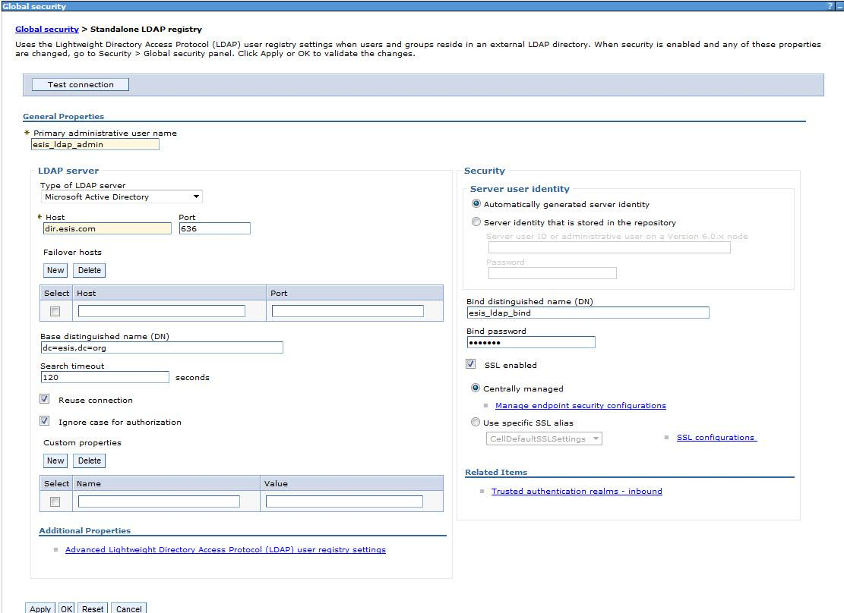
Configuring Security Cont..

Slide 10
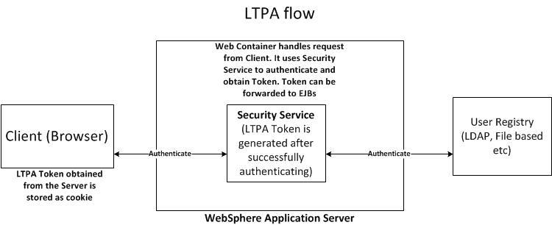
LTPA
Is the mechanism used to handle authentication
Token can be forwarded (LTPA delegation)

Slide 11
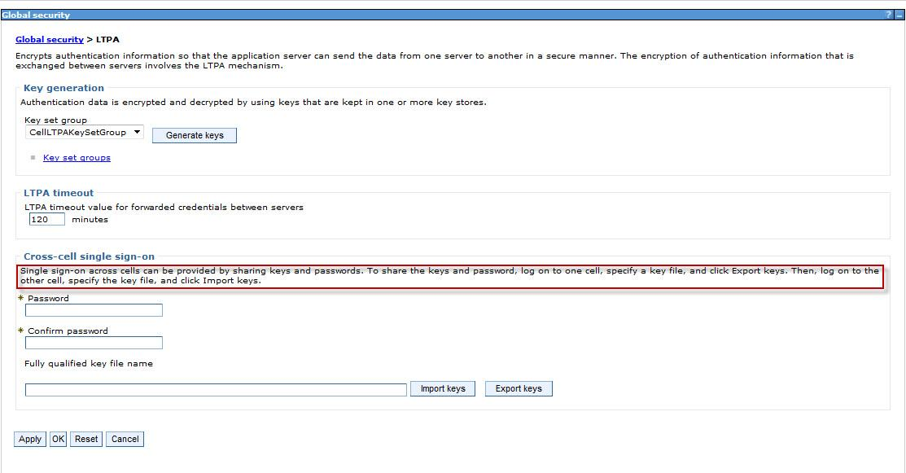
LTPA Cont…
For Single Sign on across cell, the keyfile needs to be exported in one cell and imported in another
Notes:
LTPA token is encrypted while forwarding
LTPA tokens have expiry time (120 minutes default)

Slide 12
Authorization
After authentication, WAS needs to authorize a user for the requested operation/resource
Authorization is done using roles
Notes:
Developers define the roles in Deployment descriptors
Administrator binds the roles to users/groups at deploy time or after deploy

Slide 13
SSL Basics
SSL (Secure Sockets Layer) provides Data protection and Integrity) between Server and Client
Uses Asymmetric cryptography (Public and Private key).
Shared secret key is established and is unique for each session (short lived)
Various Cipher Suites supported (highest version common to Client and Server is always chosen)
Notes:
Modern systems use TLS (Transport Layer Security) which is an evolved version of SSL.
The Server (WAS) has the public and private key pair. Public key can be sent to the client by means of Security Certificate which is signed by a certificate authority (CA)
Data encrypted using the public key can ONLY be decrypted using the private key
Private key is NEVER shared

Slide 14
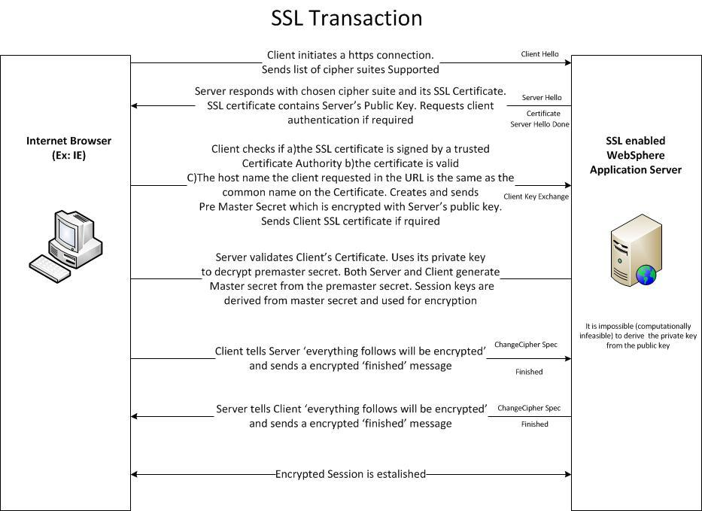
SSL Basics Cont...
Notes:
Asymmetric key cryptography is also known as public key cryptography
Public key can be 1024 bit, 2048 bit or even higher in size. 1024 is most common. 2048 is becoming popular. Bigger the size, more secure the data
Most modern browsers have standard Certificate Authorities (such as Verisign) pre installed.
In IE 9, you can see the list of certificates by going to Tools -> Internet Options -> Content -> Certificates

Slide 15
Keystores
WAS manages SSL certificates in keystores
ikeyman tool or WAS Admin Console can be used to manage keystores
Personal Certificates (Server certificates) are stored in KeyStore. CA Certificates are stored in TrustStore.
By default, each Node gets a System generated Node personal certificate and Node Signer certificate.
All Node Signer certificates are stored in CellDefaultTrustStore and distributed to all Nodes
Notes:
ikeyman tool comes with IBM HTTP Server, WAS, and HTTP Plugin. It is mainly used for managing certificates for Web Server
Since cell-wide truststore stores the signer certificate for all nodes, each node will trust other nodes in a cell.
System generated certificates are automatically renewed

Slide 16
Keystores Cont...
In practice you will install a CA signed personal certificate
Application Servers, by default will use the certificates from NodeDefaultKeystores
Keystores are organized using ‘SSL Configurations’
CellDefaultSSLSettings and NodeDefaultSSLSettings are the default
WebServers use CMS keystores and Application Servers use IBMJCE based PKCS12 keystores
Notes:
CMS Keystores have extension .kdb. IBMJCK based PKCS12 keystores have extension .p12
The CMS keystore must be propagated to the WebServer (just like plugin-cfg.xml) whenever a configuration change occurs (such as addition of a new node)

Slide 17
Requesting and installing SSL Personal Certificate
First create CSR (Certificate Signing Request) providing the ‘Common Name’ and other information
Submit CSR to a CA (certificate authority) and receive the personal certificate and signer certificate
‘Receive certificate from a certificate authority’
Ensure the singer certificate is added to the ‘trust store’

Slide 18
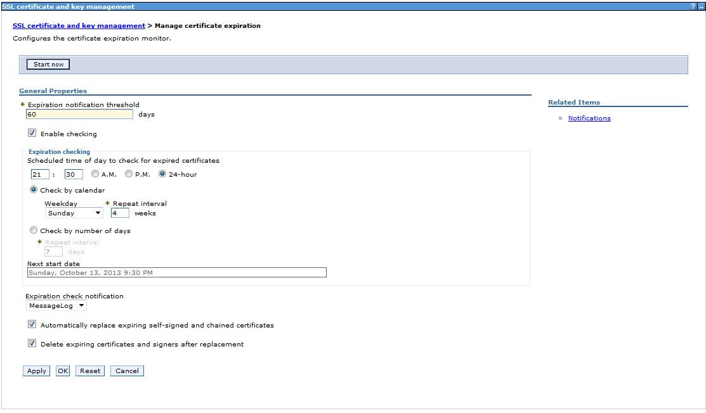
Managing Certificate expiry
Notes:
WAS can monitor and notify certificate expiry. It can also renew all System generated SSL certificates.

Slide 19
Security Auditing
Reports auditable events to ensure integrity
Authentication
Authorization
Principal/Credential Mapping
Audit policy management
Delegation
Enabled using the check box ‘Enable Auditing’ under ‘Security -> Security Auditing’ in WAS Admin Console
New event filters in addition to the default ones can be configured at Security -> Security Auditing -> Event type filters

Slide 20
Security Auditing Cont...
Audit records can be encrypted and/or digitally signed for protection
Audit Reader utility reads the binary audit log and produces HTML report
Audit reader utility can ONLY be invoked via wsadmin
AdminTask.binaryAuditLogReader
You can also view the Audit log file via a text editor, but can be difficult to read
Notes:
By default audit logs go into profile logs directory of the Application Server. The name of the file will start with ‘BinaryAudit’

Slide 21
Security Domains
Security configuration at multiple levels (i.e Cell, Application Server etc)
Cell level Security domain is the default
New security domains can be created with attributes such as ‘User registry’, ‘Java 2 security’ with different values
The new security domain can be assigned to Cluster, Server or Service Integration Bus

Slide 22
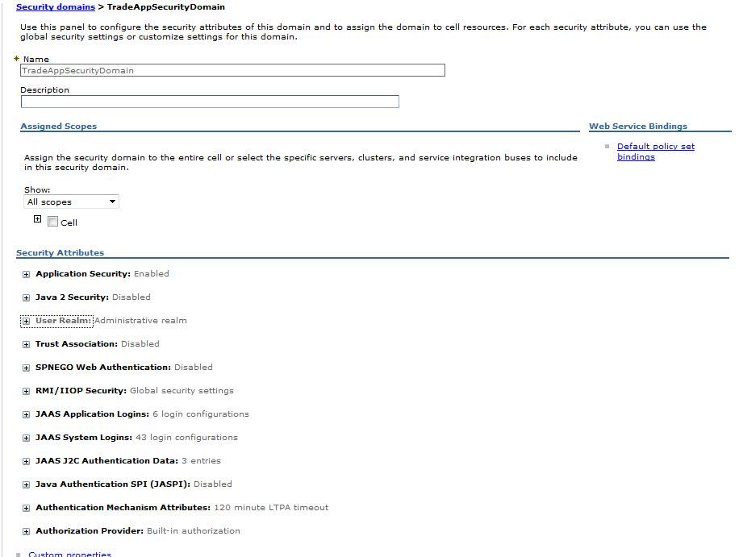
Security Domains Cont...

