Slide 1
IBM Certified WebSphere Application Server 8.5 Administrator
A course to get certified in 7 days
Karun Subramanian, ESIS Consulting LLC
Part 3

Slide 2
Section 7
Intelligent Management and Resiliency

Slide 3
Introduction
Introduced with WAS 8.5
Provides services to create virtualized Application Serving environment with minimum administrative overhead
Detect issues and dynamically change runtimes
You configure policies that govern the performance and health of the environment
Application editions enable rolling out applications without impacting users
Notes:
Intelligent management changes the traditional way of statically binding the application to a specific server or cluster. With intelligent management, you deploy the applications with ‘dynamic clusters’ as target
Operational policies that WAS administrator defines govern the application placement within Dynamic cluster
In addition to WebSphere Application Server, Intelligent management also supports Apache HTTP Server,External Java application Servers and Apache Geronimo Server

Slide 4
Components of Intelligent Management
On Demand Routers: Requests are prioritized and routed based on rules. Can be configured as Servers or run in Web Server using Intelligent Management enabled plug in
Health Management: Monitors Servers and takes actions based on health policies defined
Dynamic Clusters/Performance Management: Cluster members automatically created/removed, started/stopped based on policies defined
Application Edition Management: No downtime during Application update
Overload protection: Automatically take action based on CPU and/or Memory exhaustion
Notes:
Running On Demand Router in Web Server using Intelligent Management enabled Web Server Plugin is available only from WAS 8.5.5
On Demand Router supports HTTP and SIP protocols
ODRs can be clustered
Application Edition management enables you to roll out new application update without any downtime. You can have the new update tested while old application still serving user requests.

Slide 5
Components of Intelligent Management Cont...
Autonomic Managers
Make decisions for the environment including Application management, traffic shaping and health placement
APC - Application Placement Controller: manages Dynamic Clusters
Dynamic workload manager (DWLM)
Autonomic request flow manager (ARFM)
Health Controller
Service Policies: Settings that you define to govern the request priority
Notes:
When ODR is used in Web Server Plugin enabled for Intelligent Management, request prioritization is not supported (It is only support when ODR is configured as Server)

Slide 6
Components of Intelligent Management Cont...
Three types of Service Policies
Discretionary: Default service goal. Processed when no higher request is waiting
Avg response time: Ex: 3500 milliseconds
Percentile Response time: Ex: 90% of all requests must be processed within 2 seconds
Seven levels of importance can be set on service policy (Highest,Higher,High,Medium,Low,Lower,Lowest)
Work Class is a grouping of work to process (HTTP,SOAP,IIOP,JMS). Maps the request to a transaction Class
Notes:
HTTP and SOAP requests flow through ODR. JMS and RMI/IIOP do not flow through ODR (they are managed by the Application Server directly)

Slide 7
Components of Intelligent Management Cont...
Work class request classification rules allow requests to be classified. Uses SQL ‘where’ class style rules using the information from the request (ip,user id,header etc)
Transaction Class provides the link between application and service policy
A service policy can have multiple transaction classes mapped to it. But a transaction class must map to only one service policy

Slide 8
Components of Intelligent Management Cont...
Service Policy:
Notes:
You associate the application with a service class that can optionally have classification rules. You also map an appropriate transaction class for the service class. This can be performed in the ‘service policies’ tab on the Enterprise Application page.

Slide 9
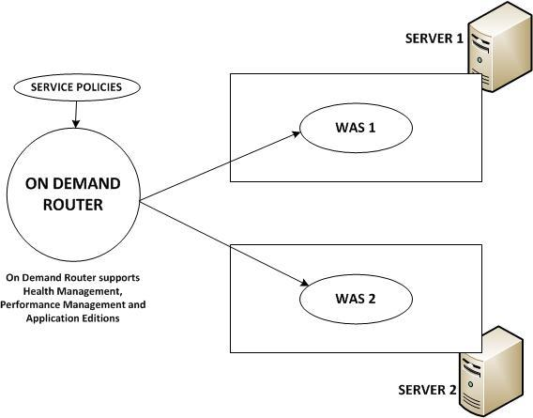
On Demand Router Explained
Java based proxy server. Sits in front of Application Servers
Routes requests to Application servers based on operational policy
Notes:
ODRs maintain session affinity just like Web Server plug-in for WebSphere
High priority work is sent to the Application Servers first. Low priority work can be queued.
ODR supports health management, performance management and Application editions
In case of a new Application server spinning up due to increased load, ODR will automatically start using this newly created Application Server in the mix.
ODR can be used to set up highly available deployment manager where it can route to an active dmgr and a hot stand by dmgr

Slide 10
Health Management
Policy driven management - monitors the system and takes actions
Health policies define what to monitor for and what to do when certain conditions are met
Health Controller (Autonomic manager) processes the Health Policies. Actions can be done automatically or with manual intervention
There is one Health Controller per cell
Notes:
Note: Health management is enabled by default.
Health Policies are one of the two operational policies in the Intelligent management. (The other is Service Policy)
System comes with predefined health conditions such as excessive memory usage and excessive response time
Health controller is a highly available controller. If active process fails, it can become active on another node agent or dmgr process

Slide 11
Health Management Cont...
Health Conditions:
Age Based
Excessive request timeout
excessive response time
Excessive memory usage
Excessive Garbage Collection
Memory Leak
Storm Drain
Work Load

Slide 12
Health Management Cont...
Health Actions
Restart Server
Take Thread dump (java core)
Take Heap dump
Put Server in maintenance mode
Take out Server from maintenance mode
Notify Administrator (SMTP)
Send SNMP trap
Custom action
Notes:
A custom health policy can use metrics collected at On Demand Router, PMI, Mbean operations and attributes

Slide 13
Application Editions
Edition Control Center manages Application editions
Enables updating the application without interrupting the users
Routing policy and on demand router are required to use two editions simultaneously
When you need to validate an edition, you can have WAS create a dynamic cluster automatically and deploy the edition for you
You must activate an edition before it can service requests
Notes:
Application Edition management enables use of multiple editions simultaneously, directing different users to different editions

Slide 14
Application Editions Cont...
Rolling out replaces the current application edition with new edition without interruption
Requests are quiesced and rerouted to other members (or temporarily queued) while the new edition is being activated
You can roll out
atomically (can queue requests at ODR to ensure two editions do not serve at the same time). Deploys on half of cluster at a time)
grouped (the group size defined by you). Does not queue requests
Notes:
Each Application edition deployed is always in one of the three states: Active, Inactive, Validation
There can be only one edition in active state and one edition in validation state for each application and deployment target combination
An edition in inactive state will NOT be started when WAS starts

Slide 15
Application Editions Cont...
You can choose to restart either just the application(soft) or the entire application server (hard)
You can specify a drainage interval for quiescing the http requests
Concurrent activation of the Application editions possible when a routing policy is defined at the ODR (ODR needs to know which group of users to route to a particular edition)
With validation mode, the deployment target is cloned and the new edition is deployed for validation. After validation rollout to original deployment target, the clone is removed

Slide 16
Autonomic Managers explained
ARFM: Autonomic request flow managers:
Controller: Governs the request flow. Runs in any node agent, ODR or dmgr
gateway: per used combination of protocol family, proxy processes and deployment target. For HTTP and SIP, runs on ODR. For JMS and IIOP, runs on WAS
Work flow estimator: per target cell. Runs in any node agent, ODR or dmgr
Dynamic Workload Controller
Dynamically adjusts server weights minimize response time. One per cluster
Notes:
Autonomic managers are set of components that deliver intelligent management
IIOP and JMS requests are NOT handled by ODR
ODR contains ARFM which prioritises the workload according to the service policies defined and protects WASs from being overloaded
ARFM reads the service policy defined by the administrator to classify work

Slide 17
Autonomic Managers explained
Application placement controller
One per cell hosted in DMGR or node agent
Manages application’s location within a node group
Starts and stops WAS instances to manage HTTP,SIP,JMS and IIOP traffic
On Demand Configuration Manager
Maintains cell topology information to keep other autonomic managers informed
Enables ODR to dynamically configure routing rules based on configuration changes such as Applications installed/removed,WASs started/stopped
Notes:
Dynamic clusters work with autonomic managers - Application placement controller for starting/stopping WAS instances, Dynamic workload controller to dynamically modify cluster weights

Slide 18
More on Service Policy
Enables classifying, prioritizing and intelligently routing workload
Sets performance goals and business importances of applications
Two components of a Service Policy
Importance: identifies most important work during resource contention
Goal:Determines how work is evaluated to ensure service policy level
Discretionary, Average Response Time, Response time percentile
Notes:
Service policies are technical implementations of SLAs (Service Level Agreements)
Discretionary Goal is the default. Indicates work is NOT significant
Average Response Time indicates work is significant. A specific time (Ex: 2000 milli seconds) is assigned
Response Time Percentile indicates work is significant. (Ex: 90% or more of requests should have 2000 milliseconds are less response time)

Slide 19
More on Service Policy Cont...
Service Policies are related to workload using ‘transaction classes’
‘Work classes’ map workload to ‘transaction classes’
Each work class is associated to:
One JEE Application
One of the following ‘type’ of requests
URL prefix for HTTP
Method name for IIOP
Bus + Destination for JMS
Each work request belongs to exactly one transaction class. Each transaction class belongs to exactly one Service Policy
Notes:
For generic clusters and SIP, work classes are not used. ODRs classifies these requests based on rules

Slide 20
Creating a Service Policy
WAS Admin Console -> Operational Policies -> Service Policy -> New
Provide a name and Goal Type (Discretionary, Avg response time or Percentile response time)
Associate an importance (lowest to highest)
Select “Monitor for persistent policy violations” to setup runtime task when policy violation occurs
Associate a ‘transaction class’ or create a new one
Notes:
If you need to create a new work class, create them under the JEE Application (work classes are per JEE Application)
WAS Admin Console -> Applications -> Application types -> WebSphere enterprise applications -> application_name -> Service policies

Slide 21
Section 8
Performance Monitoring and Tuning

Slide 22
Performance Monitoring overview
PMI (Performance Monitoring Infrastructure)
JSR-77 based JEE Management Reference implementation (JMX)
Java, WEB or JMX client can retrieve the performance data collected by PMI.
TPV (Tivoli Performance Viewer)
Viewed in Admin Console
Request Metrics
Tool that uses timing agents to track the individual request process time
Break down of a transaction showing time spent at various subsystems
Notes:
PMI is the core technology for Performance monitoring that is used in several WebSphere family of products (Commerce, Portal etc)

Slide 23
PMI
PMI can be enabled or disabled using the WAS Admin Console (enabled by default)
Enabling/Disabling requires Server restart
Various statistics set can be configured
Basic,Extended,All,Custom,None
Performance overhead of PMI can be from 2 to 6 %
Notes:
PMI can be enabled/disabled at WAS Admin console -> Monitoring and Tuning -> <Server>

Slide 24
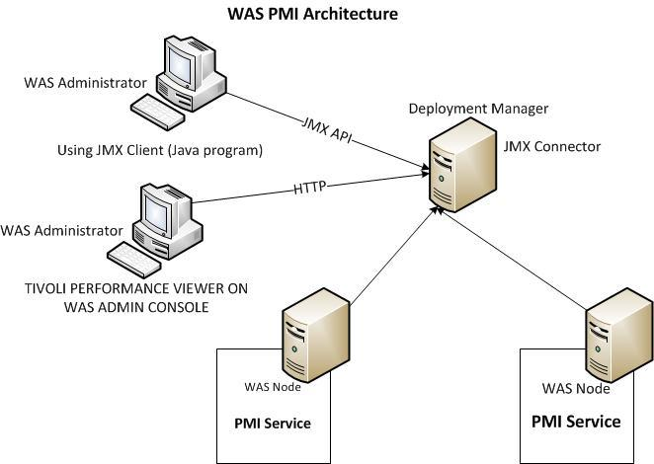
PMI Cont...

Slide 25
Request Metrics
Can be enabled/disabled using WAS Admin Console. This is a cell wide change
Various trace levels
None, Hops, Performance Debug, Debug
Finer the trace level, granular the breakdown of the response time within a transaction
HTTP Plugin must be regenerated when enabling Request Metrics
Additional filters can be configured to target the metrics collection to a particular subsystem
Output of Request Metrics can be logged to SystemOut or sent to an ARM Agent
Notes:
To access Request Metrics, navigate to Monitoring and tuning -> Request Metrics on the Admin Console
The HTTP Plugin gets updated to collect Request Metrics Stats (depending on the trace level set). This is why the Plugin needs to be updated.

Slide 26
Viewing Performance Data
Tivoli Performance Viewer is integrated with Admin Console
You can view data from only one Server at a time
Setting to modify refresh rate and buffer size
Data can be viewed as raw,rate of change or change in value
TPV data is processed by dmgr
TPV data can be logged for future use
Notes:
To start TPV, in Admin Console, click Monitoring and Tuning -> Performance Viewer -> Current Activity

Slide 27
Viewing Performance Data Cont...
Three ways in TPV
Summary Reports
General view in tabular format (Servlets, EJBs, connection pools etc)
Performance Modules
Tabular or graph view of real time performance data
Advisors
Provide tuning advice for well known hotspots (thread pool usage, jvm settings etc) based on the PMI data collected
Notes:
Data available to show via TPV depends on the PMI statistics that are enabled

Slide 28
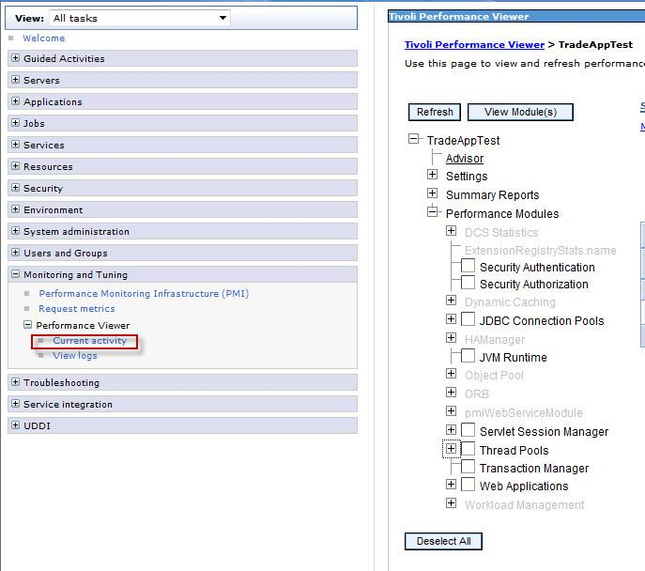
Tivoli Performance Viewer

Slide 29
Performance Advisors
Two Advisors available
Performance Advisor in TPV
Performance and Diagnostic advisor
Performance and Diagnostic advisor runs in the JVM of the WAS and hence not exhaustive. Logs advice in SystemOut.
Performance Advisor in TPV runs in nodeagent (in ND) and viewed via TPV in Admin console. Exhaustive

Slide 30
Settings that affect performance
Thread Pools: Limits the number of threads that the pool can spawn. Excessive threads generally lead to heavier CPU usage (due to context switching)
JDBC Connection Pools: Number of connections to the backend Database. Too many connections in use may indicate Connection Pool leak
JVM: GC policy must be chosen based on requirement. Frequent GC slows down the application
Notes:
While there are number of settings that can affect the performance, primary ones are Thread pools, JDBC connection Pools and JVM settings
Verbose GC logs can be useful to detect JVM memory issues. GC logs are generally written to native_stderr.log

Slide 31
WebSphere Dynamic Cache
Caches output of Servlets,JSPs,Web Services and commands
Enabled by default
Cache Monitor Web Application lets you monitor the cache performance (comes with the product)
Accessed at Server -> Container Service ->Dynamic cache
Allows disk offload and cache replication
WebSphere eXtreme scale is the strategic direction of IBM for dynamic caching
Notes:
Using Cache Monitor you can also manipulate the cache data
WebSphere eXtreme scale allows for transactional support, improved scalability and availability.
You don’t have to change any custom dynamic cache code you have when switching to eXtreme scale
eXtreme scale does NOT support disk offload (cache is processed in memory) and NO DRS style replication

